Slide 1



NEXT HIKES
EXPLORATORY DATA ANALYSIS (EDA) FOR REAL ESTATE PRICING
By Ankit

Slide 2
PROBLEM STATEMENT
  Real estate pricing depends on many factors
  Objective: Identify how size, quality, amenities, and trends affect house prices
  Provide insights for pricing strategy and property valuation
TOOLS USED: PYTHON, PANDAS, SEABORN, PLOTLY,MATPLOT, JUPYTER

Slide 3
DATA CLEANING
  Missing values handled (mode, None, median-based)
  Sparse columns (like Alley) dropped
  Duplicates removed
  Outliers checked (4000+ sqft kept as luxury homes)
  New features created: HouseAge, TotalSF, PricePerSF

Slide 4
UNIVARIATE ANALYSIS
  SalePrice Histogram + KDE
  GrLivArea Histogram
  OverallQual Countplot
  LotShape Countplot
INSIGHTS: SALEPRICE IS RIGHT SKEWED WITH A FEW HIGH VALUE LUXURY HOMES.GRLIVAREA SHOWS SIMILAR DISTRIBUTION.QUALITY AND LOT SHAPE SHOW STRONG CATEGORICAL VARIATION.

Slide 5
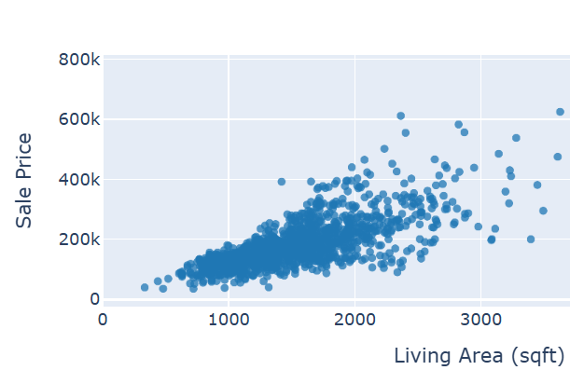
BIVARIATE ANALYSIS
  GRLIVAREA VS SALEPRICE (PLOTLY SCATTER)
  OVERALLQUAL VS SALEPRICE (BOXPLOT)
  LOTSHAPE VS SALEPRICE (BOXPLOT)
Insights:
  Bigger houses → higher price
  Quality rating is the strongest driver
  LotShape shows mild impact

Slide 6
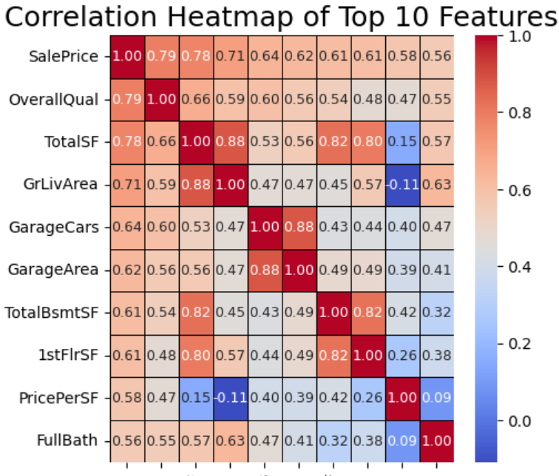
CORRELATION ANALYSIS
Insert chart:
  Top 10 Correlation Heatmap
Insights:
  OverallQual, GrLivArea, TotalSF show strongest correlation
  Garage and basement area moderate impact
  Bedroom count surprisingly weak predictor

Slide 7
FEATURE ENGINEERING
Created features:
  TotalSF = TotalBsmtSF + GrLivArea
  PricePerSF = SalePrice / GrLivArea
  HouseAge = YrSold – YearBuilt

Slide 8
SIZE IMPACT ANALYSIS
Insert charts:
  BedroomAbvGr vs SalePrice
  FullBath vs SalePrice
  TotalSF vs SalePrice (bivariate)
Insight:
TotalSF explains price far better than bedroom count.

Slide 9
MARKET TRENDS & HISTORICAL PRICING
Insert chart:
  Average SalePrice by Year Sold
Insight: Market stable across years with mild fluctuations; no strong upward trend.

Slide 10
CUSTOMER PREFERENCES & AMENITIES
Insert charts:
  GarageArea vs SalePrice
  PoolArea vs SalePrice
Insights:
  Large garage space increases price
  Pool houses are expensive but rare

Slide 11
AI INTEGRATION
  AI helped suggest color palettes for clarity
  AI guided selection of meaningful charts
  AI refined the storyline and insights

Slide 12
CONCLUSION
EDA helped uncover strong relationships influencing house prices
These insights support strategic pricing, valuation and real-estate decision-making.

Slide 13
THANKYOU

